Slide 1

Used Car Listings Dataset (U.S.A.)
A
B
Program Geog Analysis (GEOG 728A)
Name：Wei-Xuan Hu
C
D

Slide 2
Introduction
International students
Used car
Regional factors
Getting around can be challenging without a car.,
Comprehensive
comparisons are necessary.
Climate variations, terrain ruggedness, and urban-rural
Gaining a deeper understanding of the market
and considering regional factors is essential

Slide 3
Goals
To examine the feasibility of purchasing a used car as a solution for international students navigating transportation challenges in the US.
To identify and analyze the key criteria, such as affordability, condition, age, and regional factors, that influence the selection of a suitable used car.
To explore the variations in car ownership needs and preferences across different states, considering factors such as climate, terrain, and urban-rural disparities.
To provide comprehensive comparisons and guidelines to assist international students and other individuals unfamiliar with car ownership in making informed decisions when purchasing a used car in the US.

Slide 4
Research Questions
01
What are the most popular makes and models of used cars in the dataset, and do their prices vary significantly by region?
02
Do regions with high latitude and low temperatures prefer certain brands or types?
03
Do regions with high latitude and low temperatures prefer certain brands or types?

Slide 5
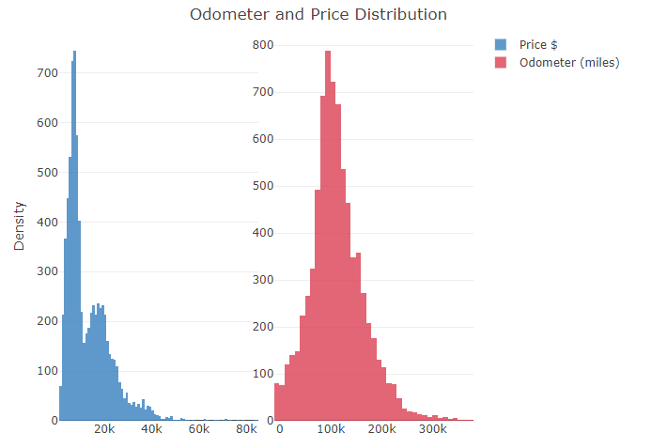
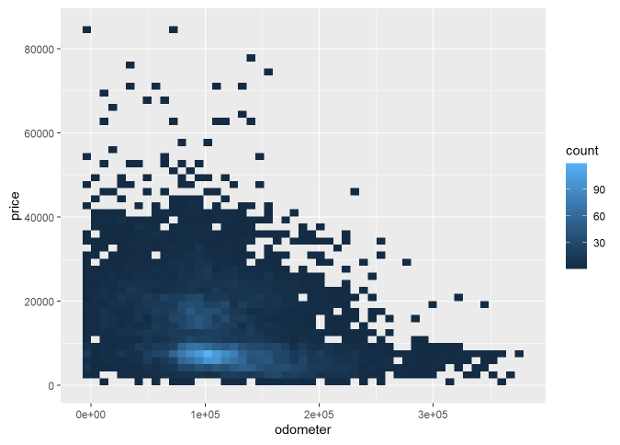
Exploratory Data Analysis

Slide 6
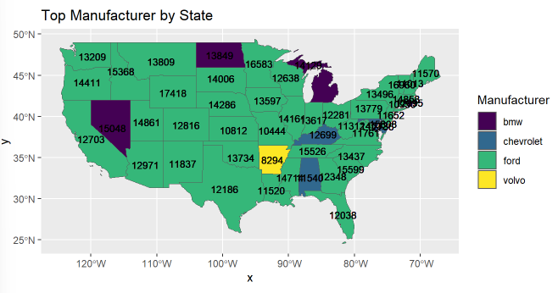
Founds and Results
What are the most popular makes and models of used cars in the dataset, and do their prices vary significantly by region?

Slide 7
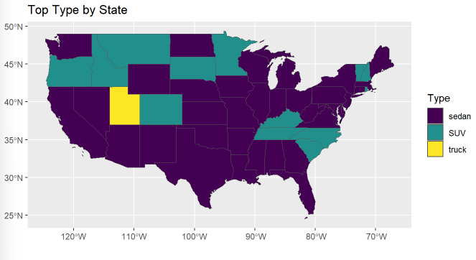
Founds and Results
Do regions with high latitude and low temperatures prefer certain brands or types?

Slide 8
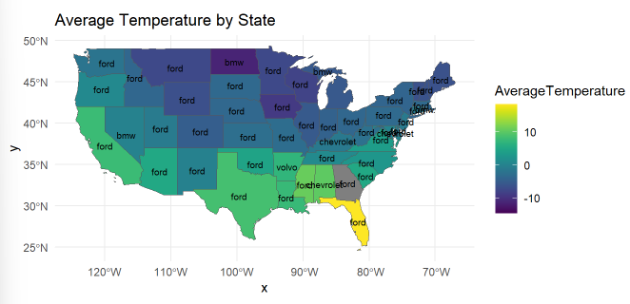
Founds and Results
Do regions with high latitude and low temperatures prefer certain brands or types?

Slide 9
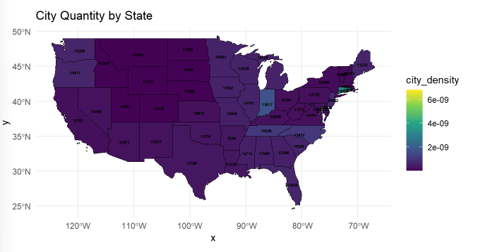
Founds and Results
Do regions with high latitude and low temperatures prefer certain brands or types?

Slide 10
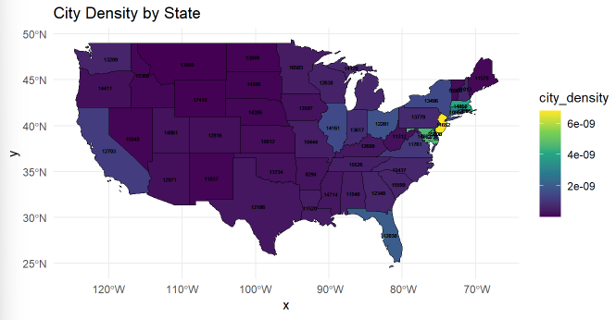
Founds and Results
Do regions with high latitude and low temperatures prefer certain brands or types?

Slide 11
Goals
Feasibility
Criteria
Variations
Comparisons
It’s the closest planet to the Sun
Mars is actually a very cold place
Jupiter is a huge gas giant
Neptune is far away from us
This template has been created by Slidesgo

Slide 12
How to Create an Infographic
Visual balance
Color palette
Earth is the third planet from the Sun and has life
Venus has a beautiful name, but also high temperatures
50%
50%
Main color
Secondary colors
This template has been created by Slidesgo

Slide 13
How to Create an Infographic
Mercury
Mars
It’s the closest planet to the Sun
Mars is actually a very cold place
Jupiter
Neptune
Venus has extremely high temperatures
75%
Venus is extremely hot, even more than Mercury
25%
This template has been created by Slidesgo

Slide 14
How to Create an Infographic
Use of icons and graphics
Saturn has beautiful rings
Saturn
Saturn is the ringed planet
Mars is actually a very cold place
Mars
Despite being red, Mars is very cold
This template has been created by Slidesgo

Slide 15
How to Create an Infographic
Jupiter
Mars
Saturn
Earth
Neptune
Mars is actually a very cold place
Saturn is the ringed planet
Earth is the planet with life
Neptune is far away from us
This template has been created by Slidesgo

Slide 16
How to Create an Infographic
Font selection
A
Jupiter
Jupiter is the biggest planet of them all
50%
A
Venus
Venus is the second planet from the Sun
75%
a
Saturn
It’s composed of hydrogen and helium
25%
This template has been created by Slidesgo

Slide 17
How to Create an Infographic
Types of infographics
Lists
Diagrams
Chronological
It’s the closest planet to the Sun
Jupiter is a huge gas giant
Earth is the planet with life
This template has been created by Slidesgo

Slide 18
How to Create an Infographic
50%
01
Mars is full of iron oxide dust
50%
02
Neptune is far away from us
75%
03
Saturn has beautiful rings
25%
04
Jupiter is a huge gas giant
This template has been created by Slidesgo

Slide 19
How to Create an Infographic
Usability and accessibility
Effectiveness
Efficiency
Saturn has beautiful rings
Mars is actually a very cold place
Responsive
Earth is the planet with life
This template has been created by Slidesgo

Slide 20
How to Create an Infographic
Mars
Mars is full of iron oxide dust
Jupiter
Neptune
Neptune is far away from us
Saturn
Saturn has beautiful rings
This template has been created by Slidesgo

Slide 21
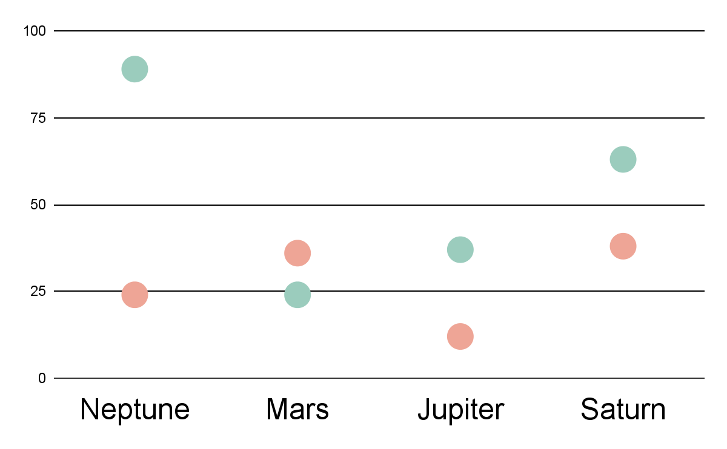
How to Create an Infographic
Infographics in marketing
Neptune
Mars
Neptune is far away from us
Mars is full of iron oxide dust
Jupiter
Saturn
Jupiter is a huge gas giant
Saturn has beautiful rings
Earth
Venus
Follow the link in the graph to modify its data and then paste the new one here. For more info, click here
This template has been created by Slidesgo

Slide 22
How to Create an Infographic
Mars
Saturn
Mars is actually a very cold place
Saturn is the ringed planet
Mercury
Neptune
It’s the closest planet to the Sun
Neptune is far away from us
This template has been created by Slidesgo

Slide 23
How to Create an Infographic
50%
25%
75%
Mercury
Mars
Saturn
It’s the closest planet to the Sun
Mars is actually a very cold place
Saturn has beautiful rings
This template has been created by Slidesgo

Slide 24
How to Create an Infographic
 | Phase 1 | Phase 2 | Phase 3
Mercury
Venus
Jupiter
Data compilation: 987
Incomplete
Completed
This template has been created by Slidesgo

Slide 25
How to Create an Infographic
Jupiter
Saturn
Jupiter is the biggest planet of them all
Saturn is composed of hydrogen and helium
Jupiter doesn’t have a solid surface
Saturn was named after a Roman god
Jupiter was named after a Roman god
Saturn is a gas giant and has several rings
This template has been created by Slidesgo

Slide 26
How to Create an Infographic
Earth is also known as the Blue Planet
Mars is full of iron oxide dust
Venus is the second planet from the Sun
Neptune is far away from us
Jupiter doesn’t have a solid surface
Saturn was named after a Roman god
This template has been created by Slidesgo

Slide 27
Icon pack
This template has been created by Slidesgo

